Slide 1
Aldershot Town F.C. Fans Forum
September 2021

Slide 2
Contracts offered to Retain Players
Josh Rees
Harrison Panayiotou
Joel Nouble
Jermaine Anderson
Craig Tanner

Slide 3
Transfer Negotiations
Will Evans
Frankie Raymond
Adi Yussuf
Kwame Thomas
Saidou Khan
Andrew Dallas
Danilo Orsi-Dadomo
Josh Passley
Shad Ogie
Ethan Coleman
Virgil Gomis
Mo Sagaf
Brendan Kiernan
Charlie Grainger
Jack Cawley
Andrew Elftheriou
Mitch Brundle
Haji Mnoga
Lois Maynard
Ali Omar
Jordan Maguire-Drew

Slide 4
Squad Age
2019 – 2020 Average 22.3 Youngest in the League
2020 – 2021 Average 23.0 Youngest in the League
2021 – 2022 Average 23.4 Youngest in the League

Slide 5
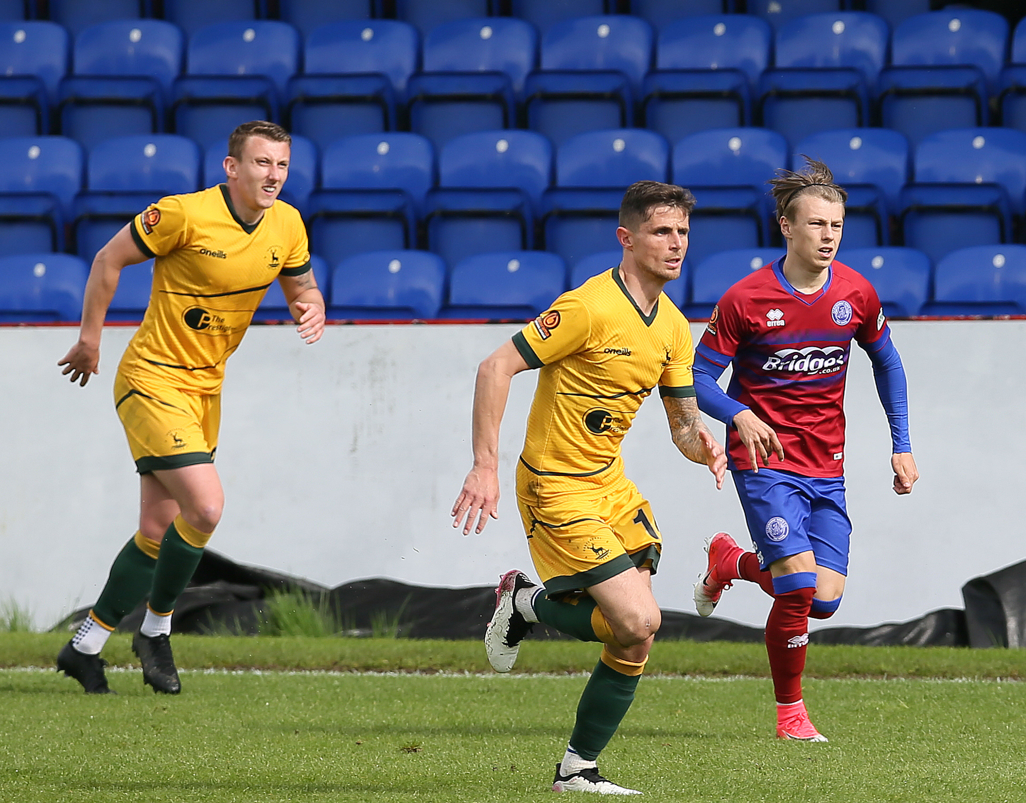
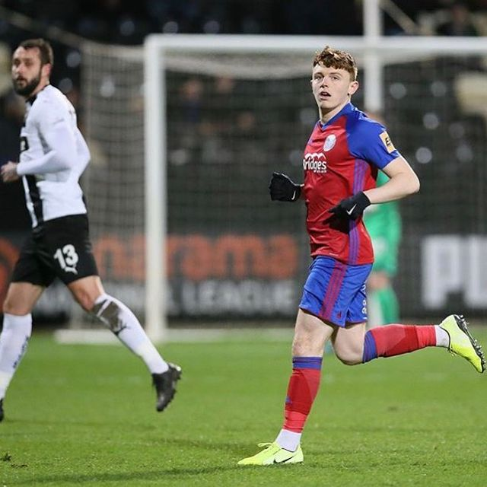
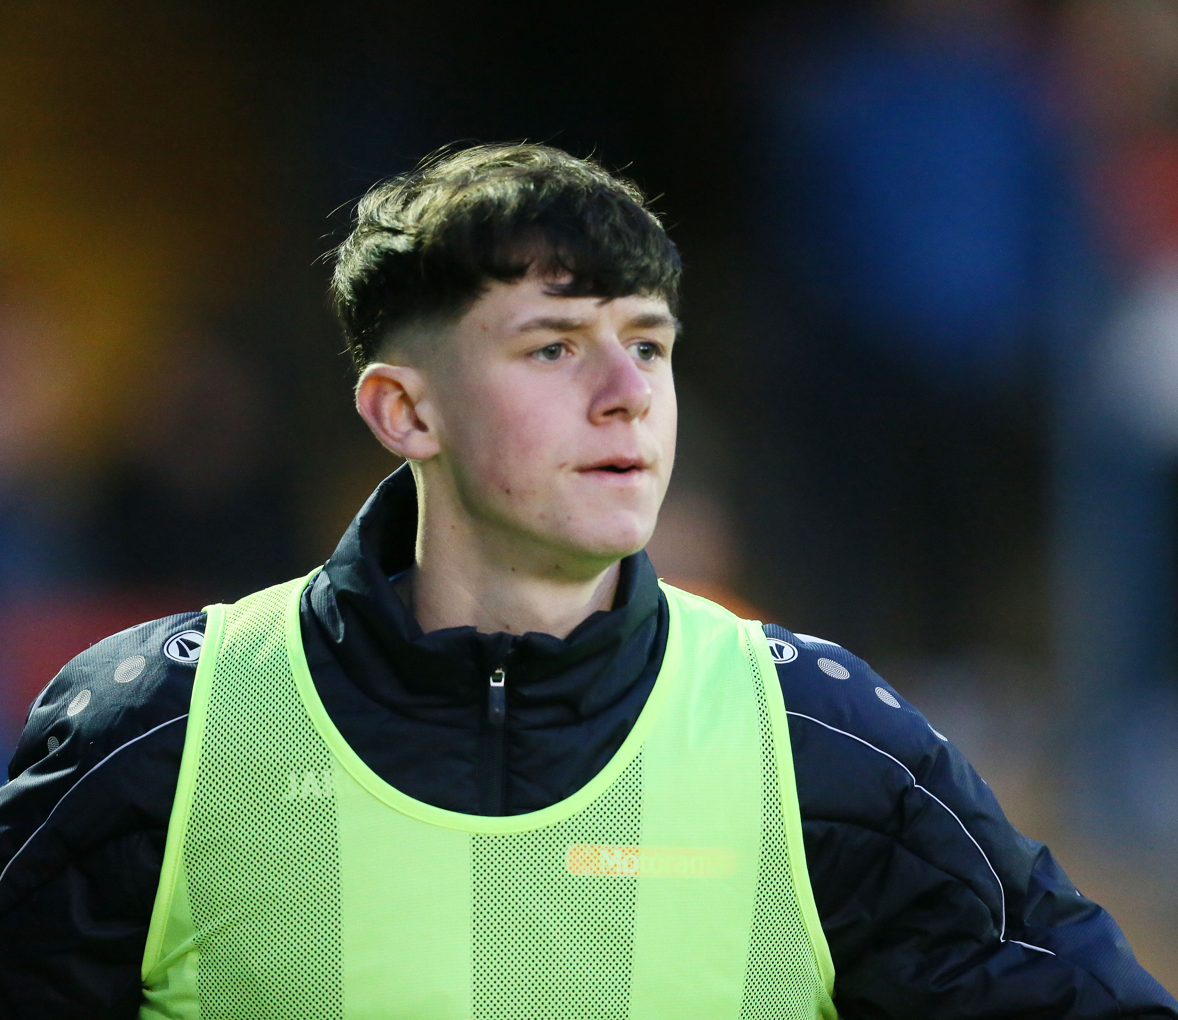
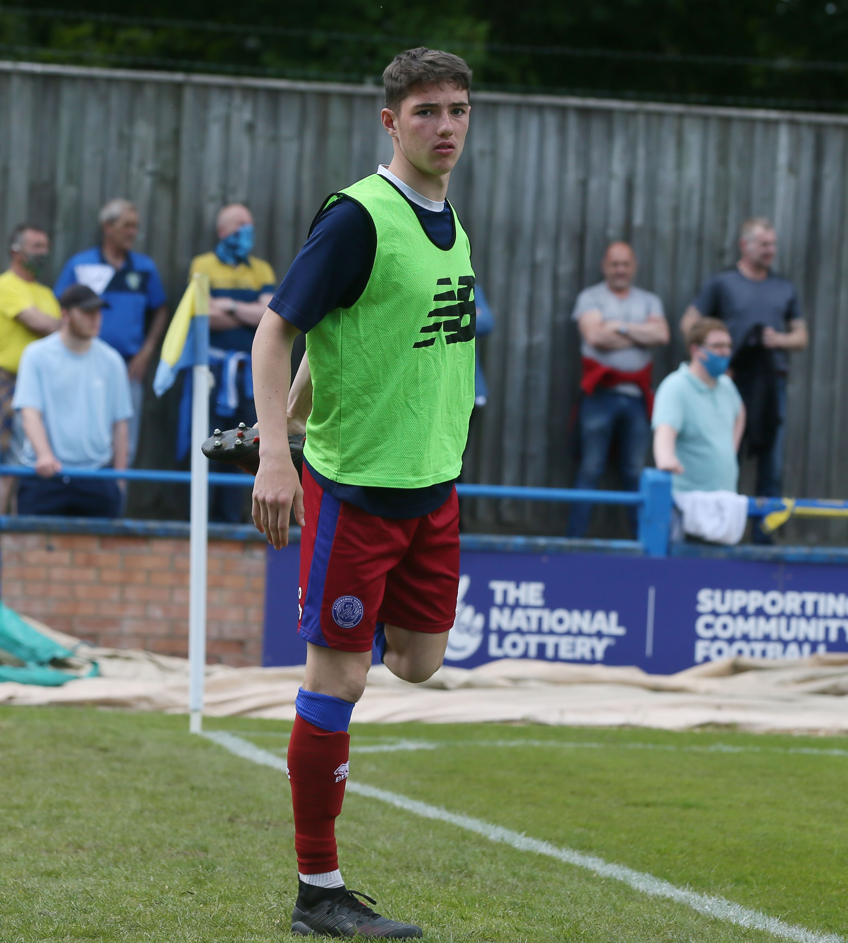
Academy Debuts

Slide 6
Improvements

Slide 7
No.1 | Team
1 | Wrexham
2 | Chesterfield
3 | Notts County
4 | Stockport County
5 | Bromley
6 | Boreham Wood
7 | Dagenham & Redbridge
8 | Grimsby Town
9 | Southend United
10 | Barnet
11 | Solihull Moors
12 | Torquay United
13 | Yeovil Town
14 | Eastleigh
15 | Halifax Town
No.1 | Team
16 | Woking
17 | Altrincham
18 | Maidenhead
19 | Kings Lynn
No.1 | Team
20 | Aldershot Town
21 | Wealdstone
22 | Weymouth
23 | Dover Athletic

